Slide 1
Recognizing & Rewarding Community Engagement
BigTen Community Engagement Leaders Meeting
May 29, 2025

Slide 2
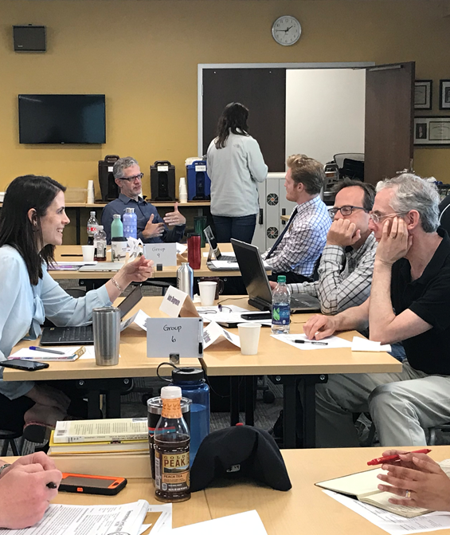
Revising P&T at Iowa
1 ½ year long project to revise Promotion & Tenure guidelines at the institutional level to incorporate community-engaged scholarship
Context that promoted project:
  Increasing interest from faculty in community-engaged scholarship
  Desire for research, teaching and creative activity to make a difference in communities
  Recruitment and retention: statistics showing junior faculty particularly interested in this work
But…..

Slide 3
Supporting Community Engagement
Faculty increasingly expressed that:
  Current P&T standards and processes did not incorporate community-engaged work
  Current P&T standards and processes often hindered community-engaged work
  Lack of clarity on where barriers to P&T changes occurred…
    Dean’s office: “It’s up to the departments to make changes to their standards and bring them to us”
    Departments: “We need the Dean’s office or Provost Office to demonstrate support before we can change our guidelines!”

Slide 4
P&T Revision Process
Led by Office of Community Engagement (Faculty Fellow + Executive Director) collaboration with Associate Provost for Faculty
  Months 1 – 4: Research best practices, current institutional
  standards, peer institution examples, campus climate survey
Months 4 – 12: Develop strategy for P&T revisions, draft revised guidelines in collaboration with key stakeholder groups
Months 12 – 15: Present final draft P&T revisions to key stakeholder groups
Month 16: Launch new guidelines via Provost Office and Office of Community Engagement

Slide 5
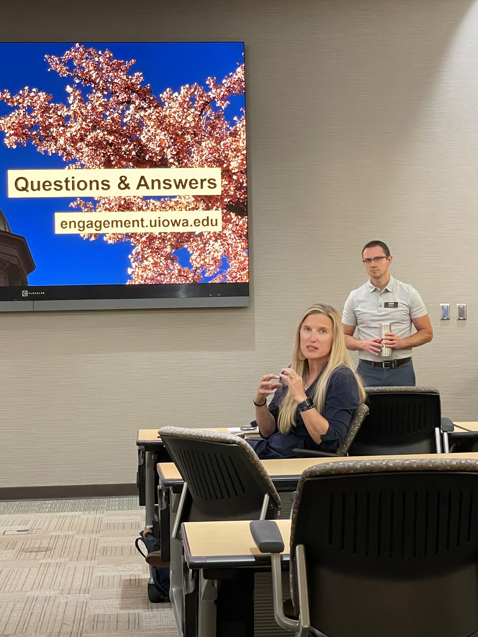
Key Stakeholders
Associate Deans for Faculty
Faculty Council
Dean’s Council and President’s Cabinet
UI Strategic Plan Faculty Development Group
Individual colleges, key departments
Community-engaged faculty

Slide 6
Reviewing Engaged Scholarship
Valuing process – relationships with the community are foundational
Rethinking products– publications in interdisciplinary or engagement journals, public scholarship, white papers or contributions to policy, solutions focus (building organizational capacity, programs, or interventions), presentations or community meetings, grants received, other indicators of process or relationship quality
Assessing impact – consider impact not just to the research area but to the social issue; at the local or community level, not just nationally/internationally

Slide 7
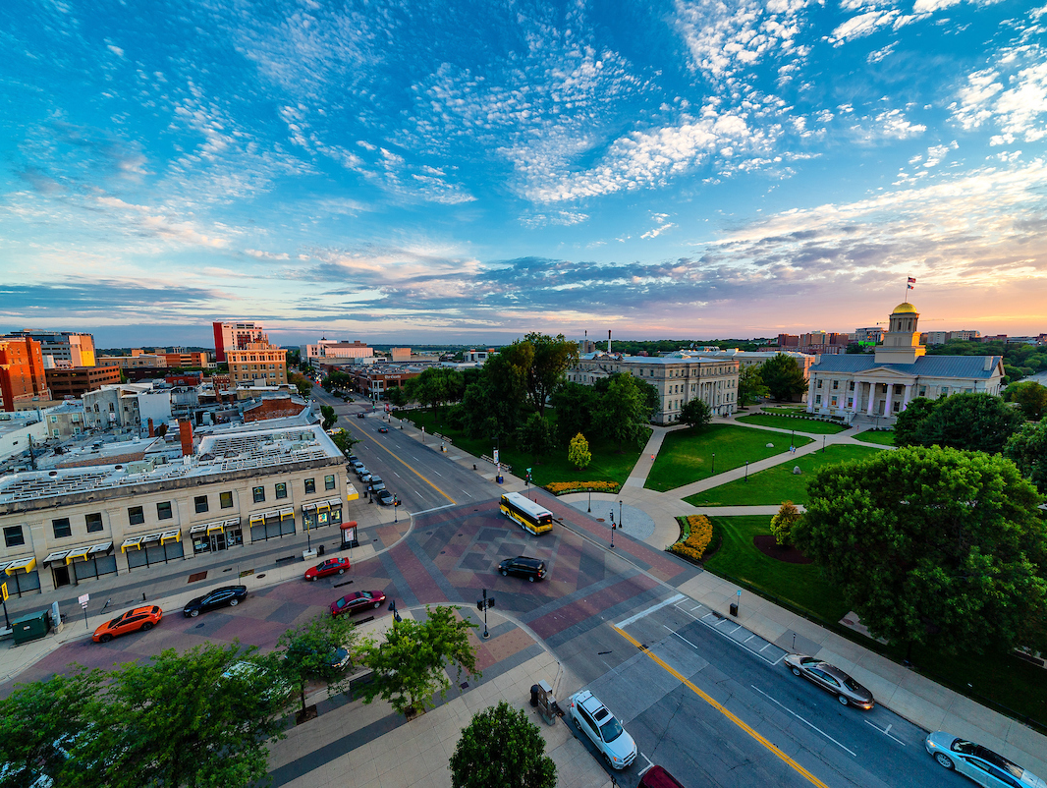
Other schools

Slide 8
Three Review Models
A separate track for community engagement
  University of Illinois
Incorporating community engagement into standard review documents, at the university level
  UNC-Greensboro
Additional university review of engaged scholarship + education/training
  University of Minnesota

Slide 9
At Iowa

Slide 10


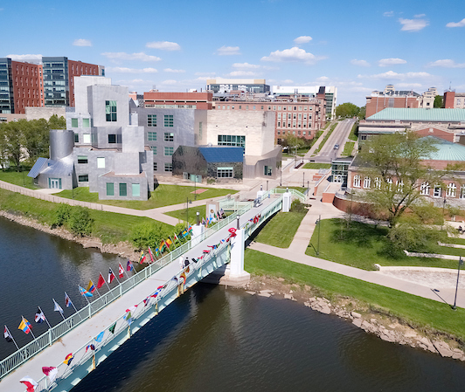
Iowa’s P&T guidelines
P&T guidelines are very broadly written
Some but not all colleges/departments have their own, more detailed guidelines
Only 2 departments have P&T guidelines that incorporate community-engaged scholarship

Slide 11
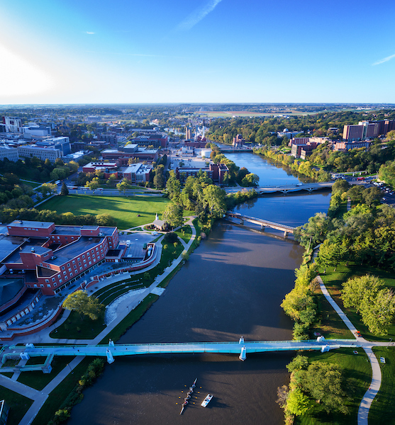
Our Approach
An addendum to university P&T guidelines that can be adopted by colleges and/or departments. Packet includes:
  Background documents (what is engaged scholarship, why review it differently)
  Proposed timeline (earlier the better...)
  Memorandum of Understanding (MOU)/Checklist to be developed by faculty member and DEO, including agreed-upon indicators of impact
  Draft language for external reviewers
  Guidelines on community-engaged teaching assessment
  Guidelines on a community-engaged scholarship statement, for the promotion package
  Adapted for TT and Instructional Track Faculty

Slide 12
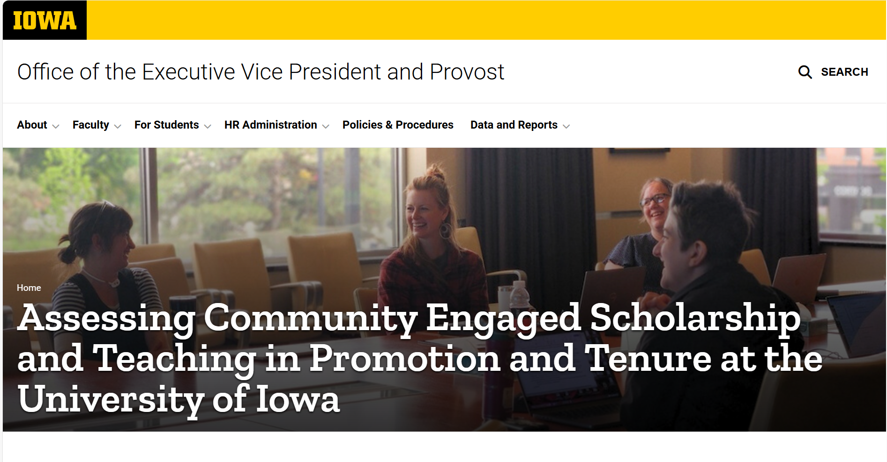
Revised Guidelines

Slide 13
Discussion
uiowa.edu

Slide 14
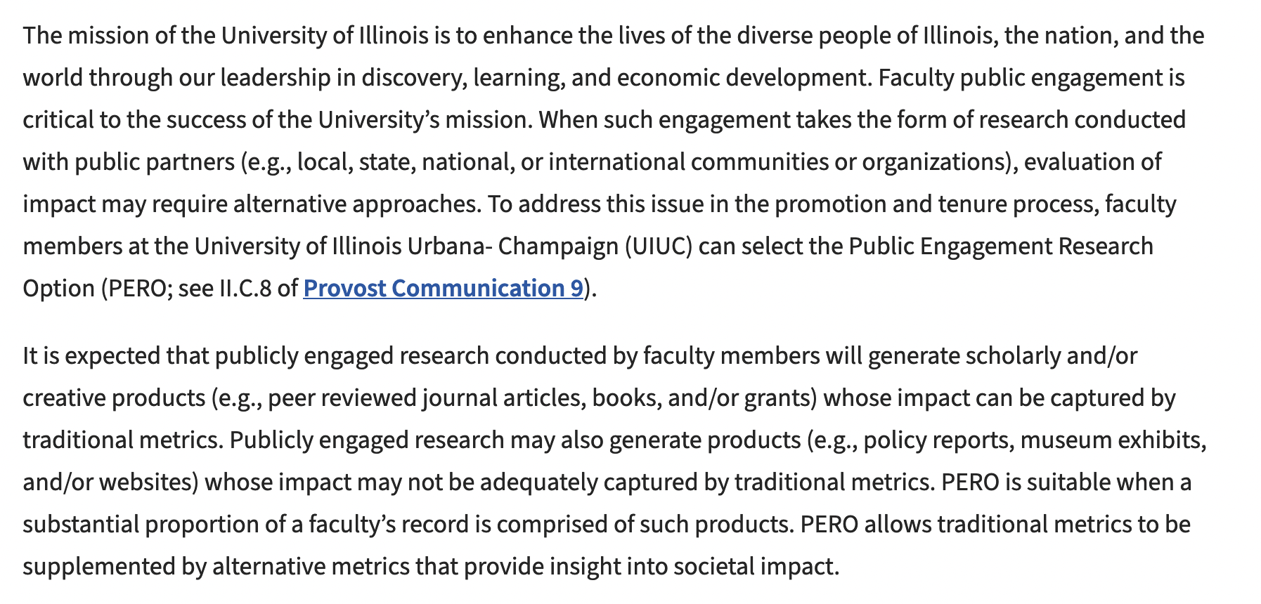
Illinois – Publicly Engaged Research Option

Slide 15
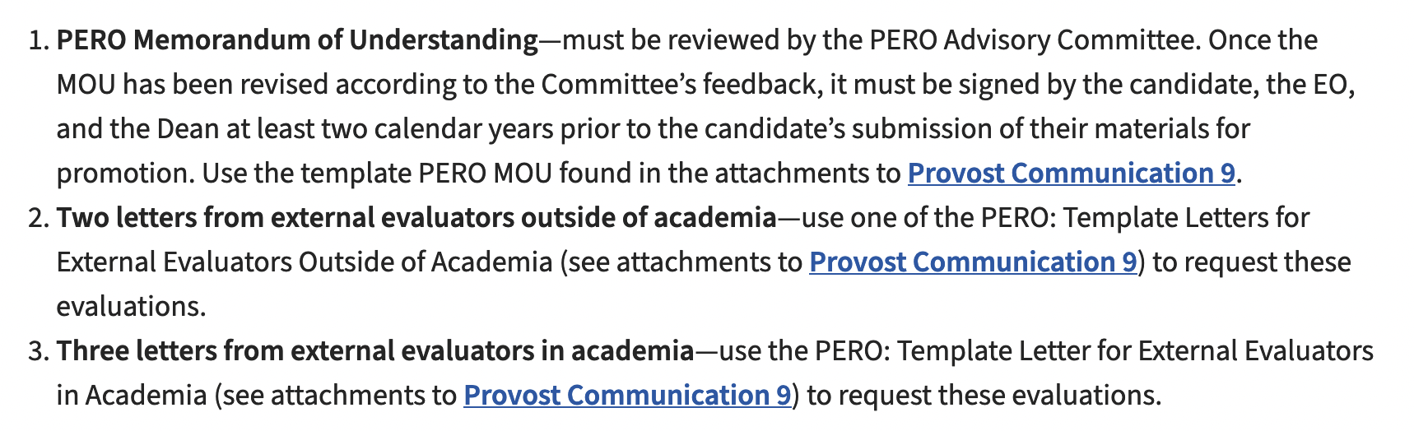
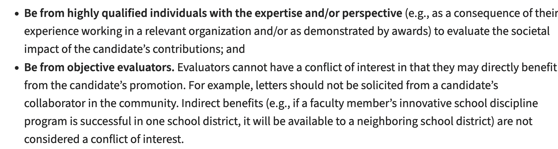
Illinois – Publicly Engaged Research Option

Slide 16
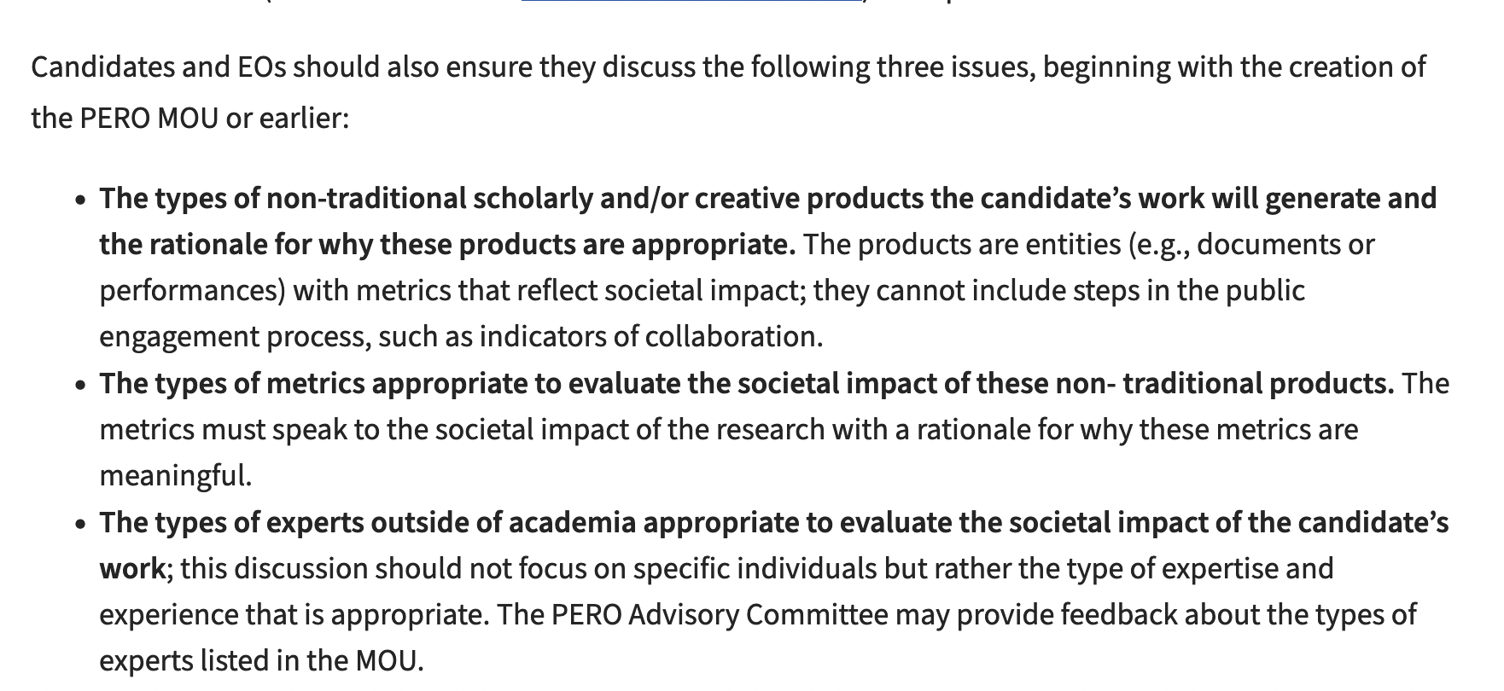
Illinois – Publicly Engaged Research Option

Slide 17
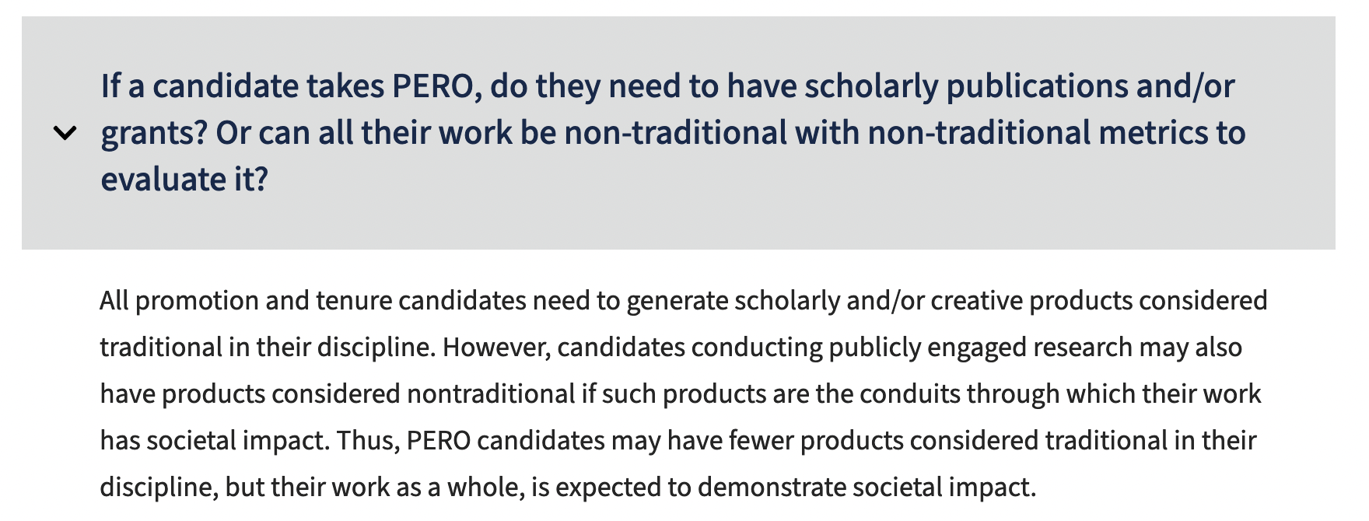
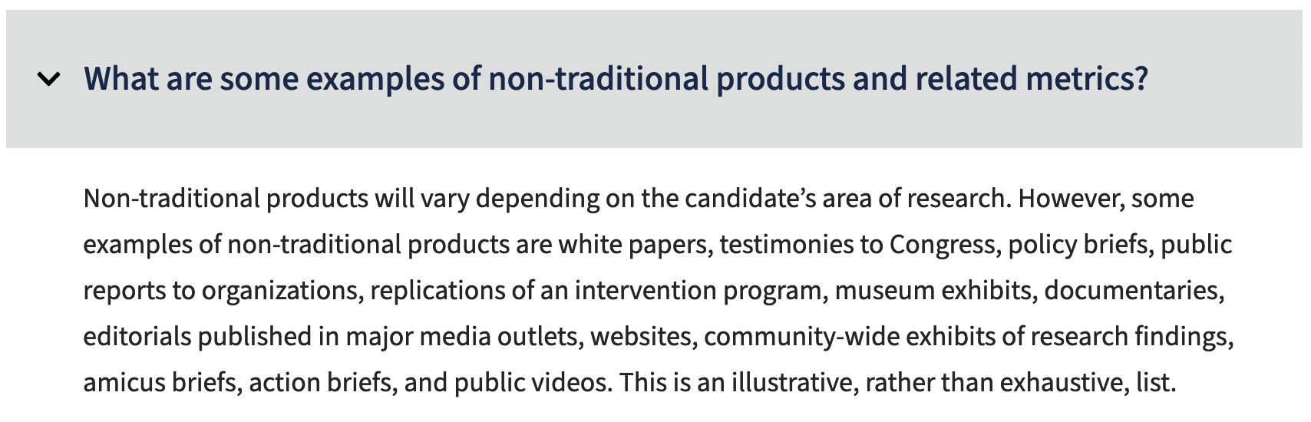
Illinois – Publicly Engaged Research Option

Slide 18
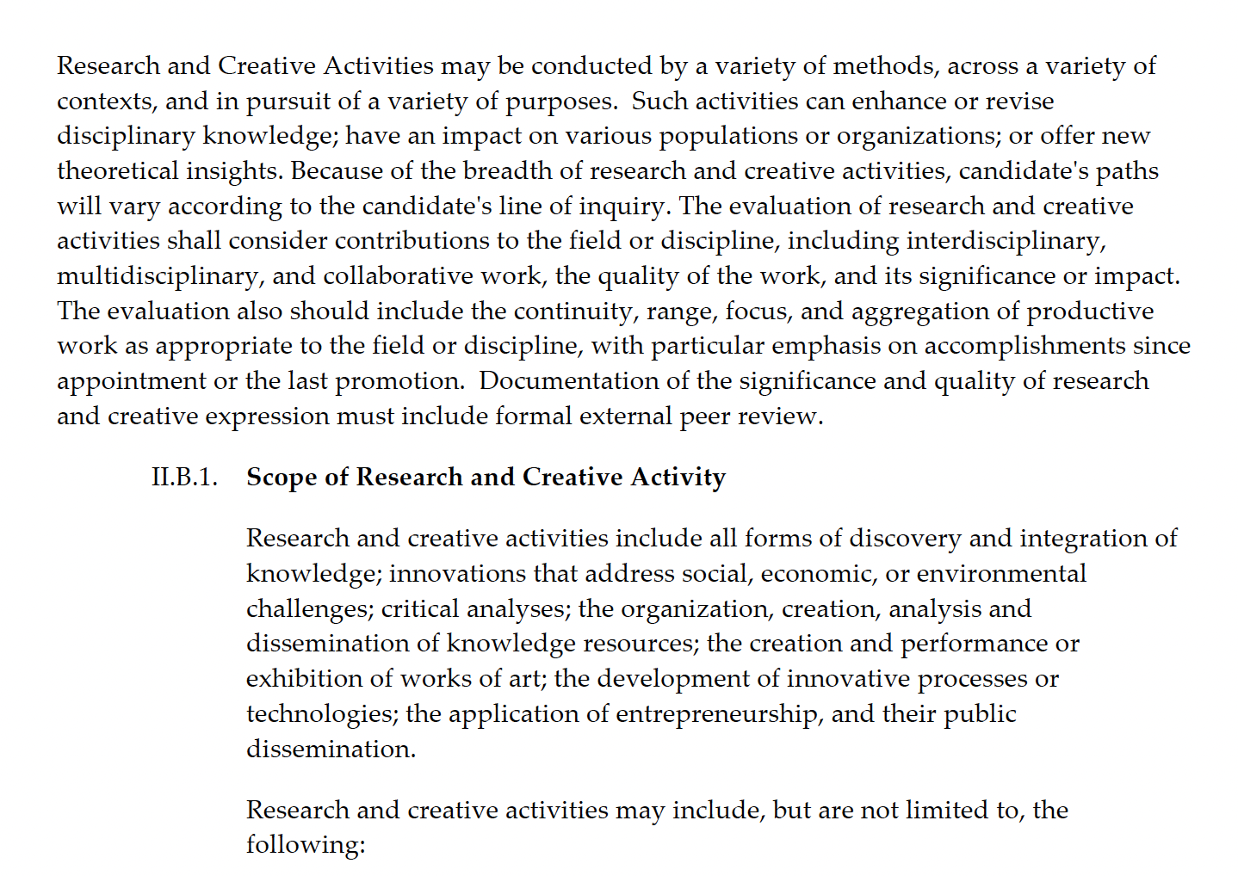

UNC Greensboro – Engagement in P&T

Slide 19
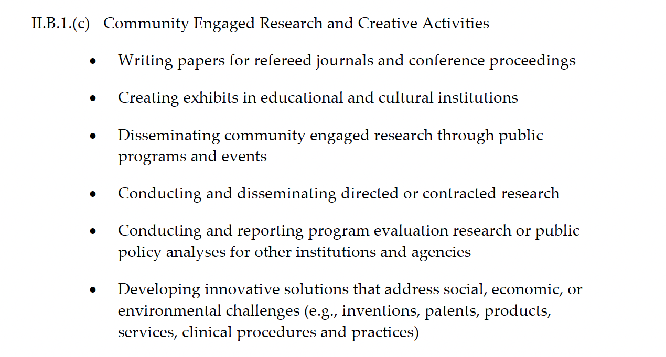
UNC Greensboro

Slide 20
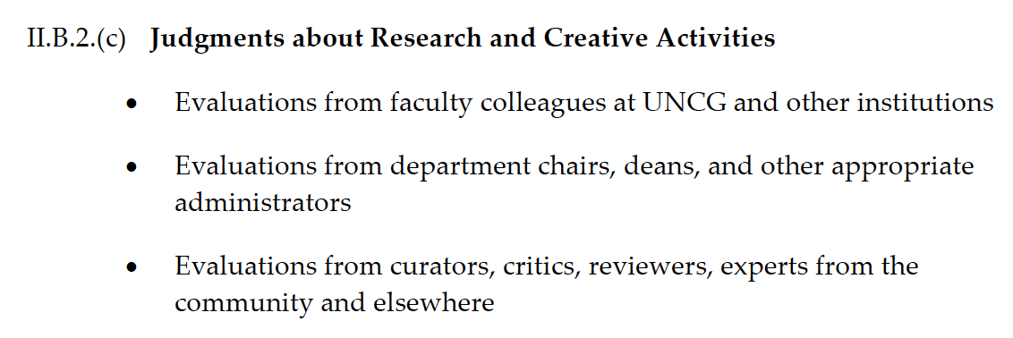
UNC Greensboro

Slide 21
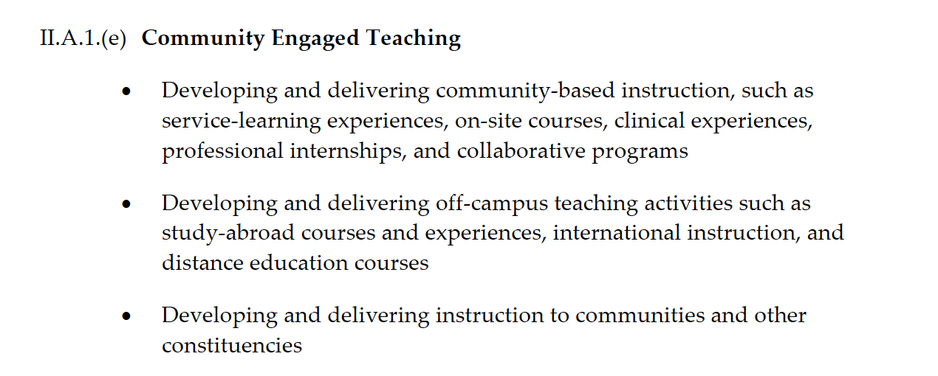
UNC Greensboro

Slide 22
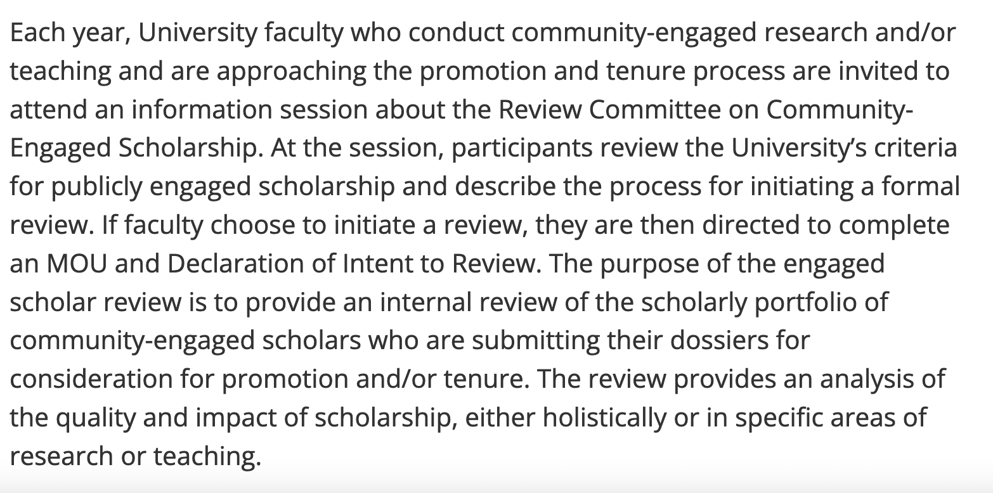
Minnesota – Internal Review Committee

Slide 23
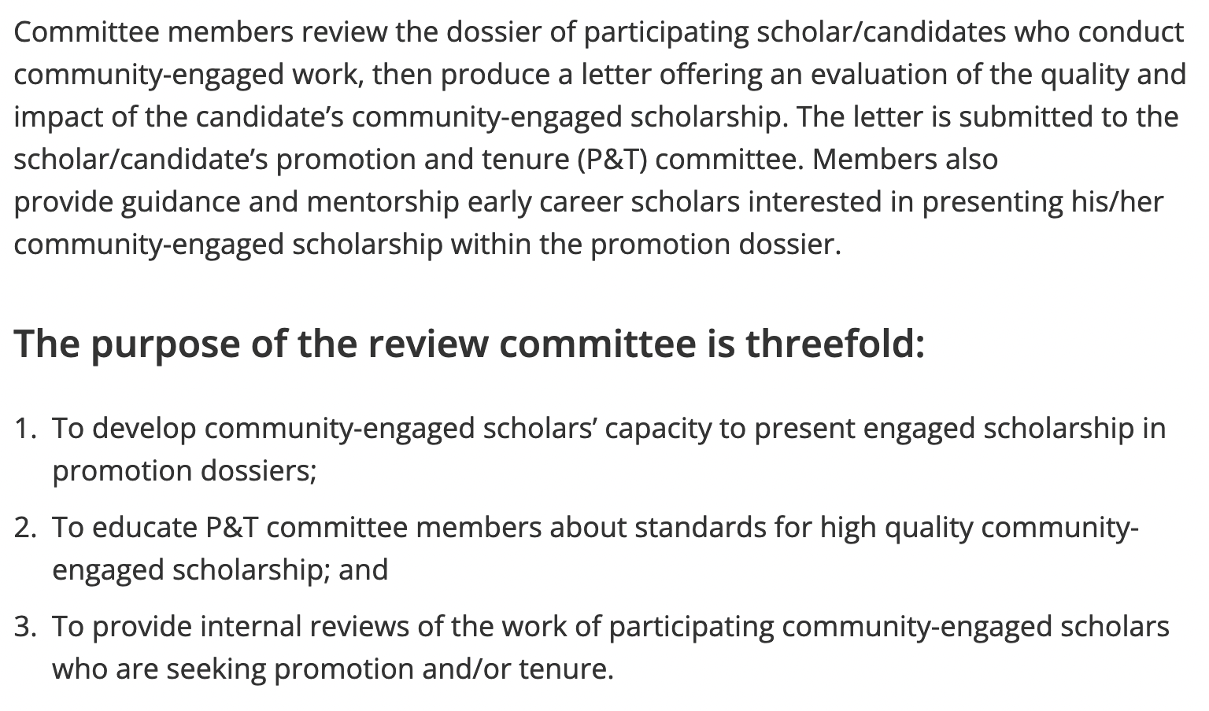
Minnesota – Internal Review Committee

Slide 24
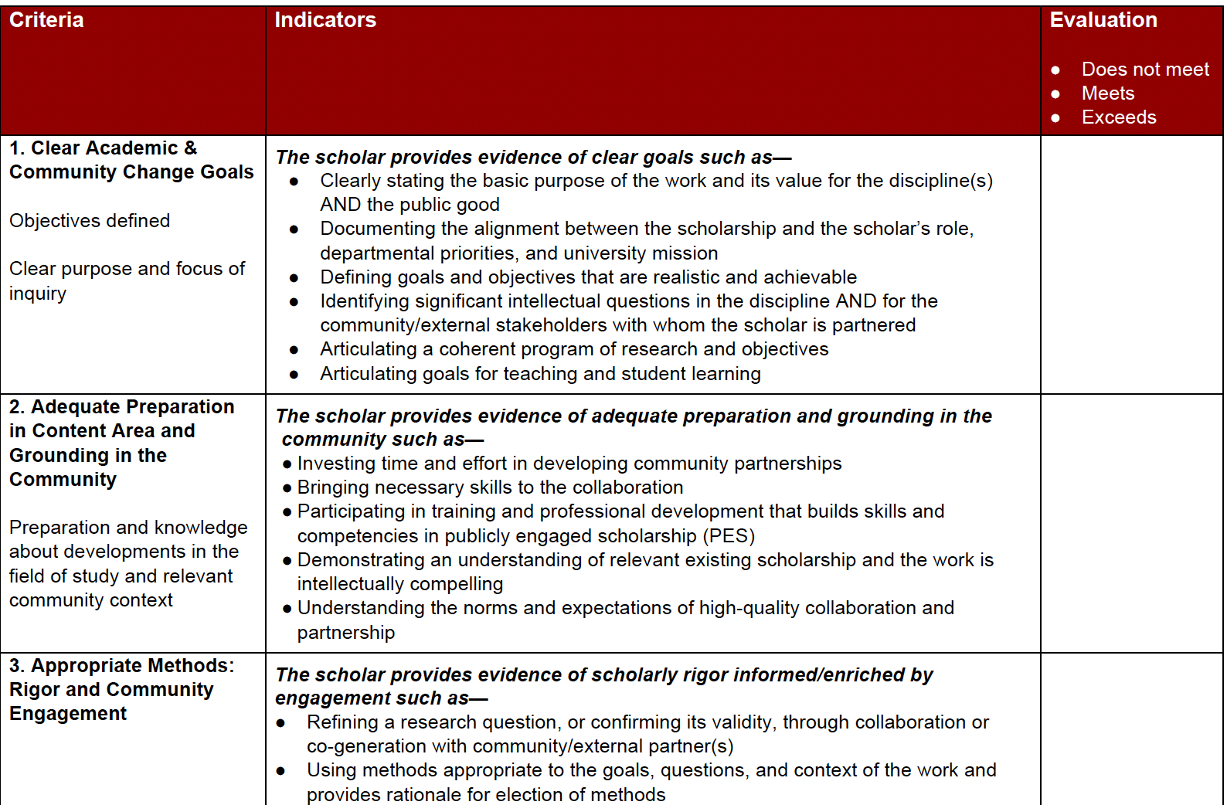
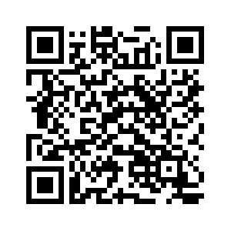
Minnesota – Internal Review Committee
More about Minnesota’s review committee

