Slide 1

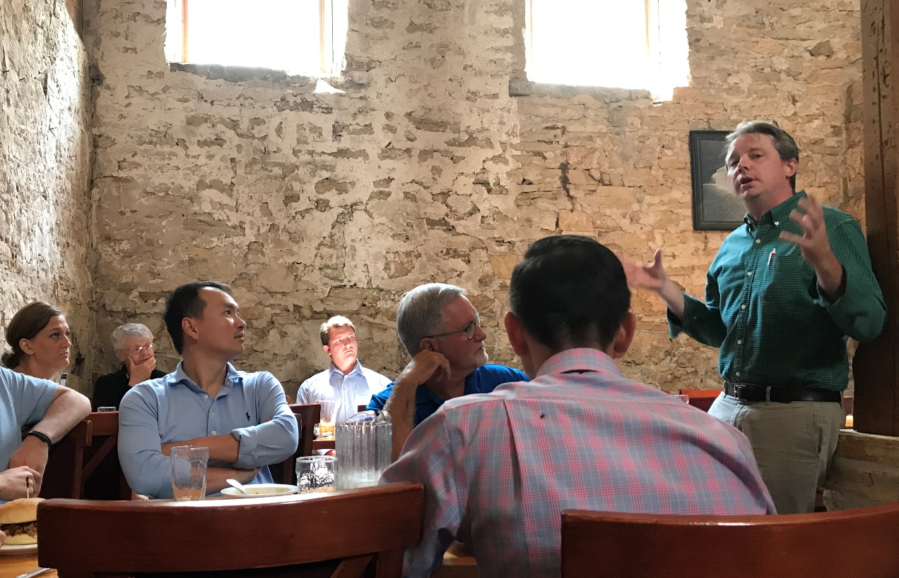
Community Engagement and Promotion &Tenure
June 2026

Slide 2
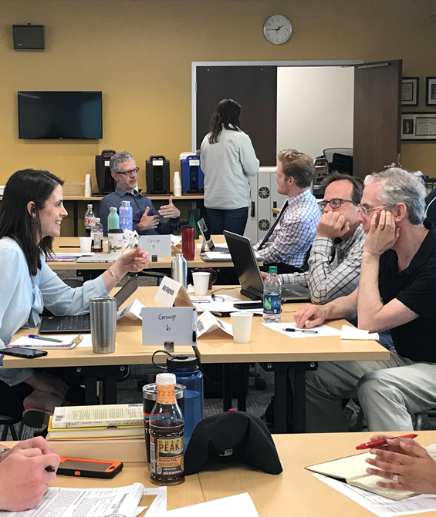
Community engagement and P&T at Iowa
Multi-year project to create Promotion & Tenure guidelines at the institutional level to incorporate community-engaged scholarship
Context that promoted project:
  Increasing interest from faculty in community-engaged scholarship (years of informal conversations)
  Desire for research, teaching and creative activity to make a difference in communities
  Recruitment and retention: statistics showing junior faculty particularly interested
But…..

Slide 3
Challenges to Community Engaged Scholarship
Faculty increasingly expressed:
  Current P&T standards and processes did not incorporate community-engaged work
  Current P&T standards and processes often hindered community-engaged work
  Confusion about where barriers to P&T occurred:
    Dean’s office: “It’s up to the departments to make changes to their standards and bring them to us,”
    Departments: “We need the Dean’s office or Provost Office to demonstrate support before we can change our guidelines.”

Slide 4
P&T Guidelines Development
Led by Office of Community Engagement (Faculty Fellow + Executive Director) collaboration with Associate Provost for Faculty
    Spring 2024: Research best practices, current institutional standards, peer institution examples, campus climate survey
    Spring 2024-Fall 2024: Develop strategy for P&T guidelines, draft guidelines in collaboration with key stakeholder groups
    Spring 2025: Present final P&T revisions to campus stakeholder groups
    May 2025: Launch new guidelines via Provost Office and Office of Community Engagement
    Fall 2025 – Spring 2026: Implement guidelines across campus

Slide 5
Reviewing Engaged Scholarship
Valuing process – relationships with the community are foundational
Rethinking products– publications in interdisciplinary or engagement journals, public scholarship, white papers or contributions to policy, solutions focus (building organizational capacity, programs, or interventions), presentations or community meetings, grants received, other indicators of process or relationship quality
Assessing impact – consider impact not just to the research area but to the social issue; at the local or community level, not just nationally/internationally

Slide 6


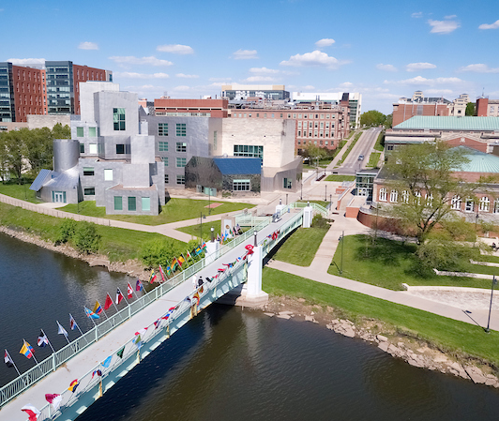
Institutional guidelines
P&T guidelines are very broadly written at institutional level
Some but not all colleges/departments have their own, more detailed guidelines
Only 2 departments have P&T guidelines that incorporate community-engaged scholarship

Slide 7

Community-engaged scholarship guidelines
An addendum to university P&T guidelines that can be adopted by colleges and/or departments. Packet includes:
  Background documents (what is engaged scholarship, why review it differently)
  Proposed timeline (earlier the better...)
  Memorandum of Understanding (MOU)/Checklist to be developed by faculty member and DEO, including agreed-upon indicators of impact
  Draft language for external reviewers
  Guidelines on community-engaged teaching assessment
  Guidelines on a community-engaged scholarship statement, for the promotion package
  Adapted for TT and Instructional Track Faculty

Slide 8
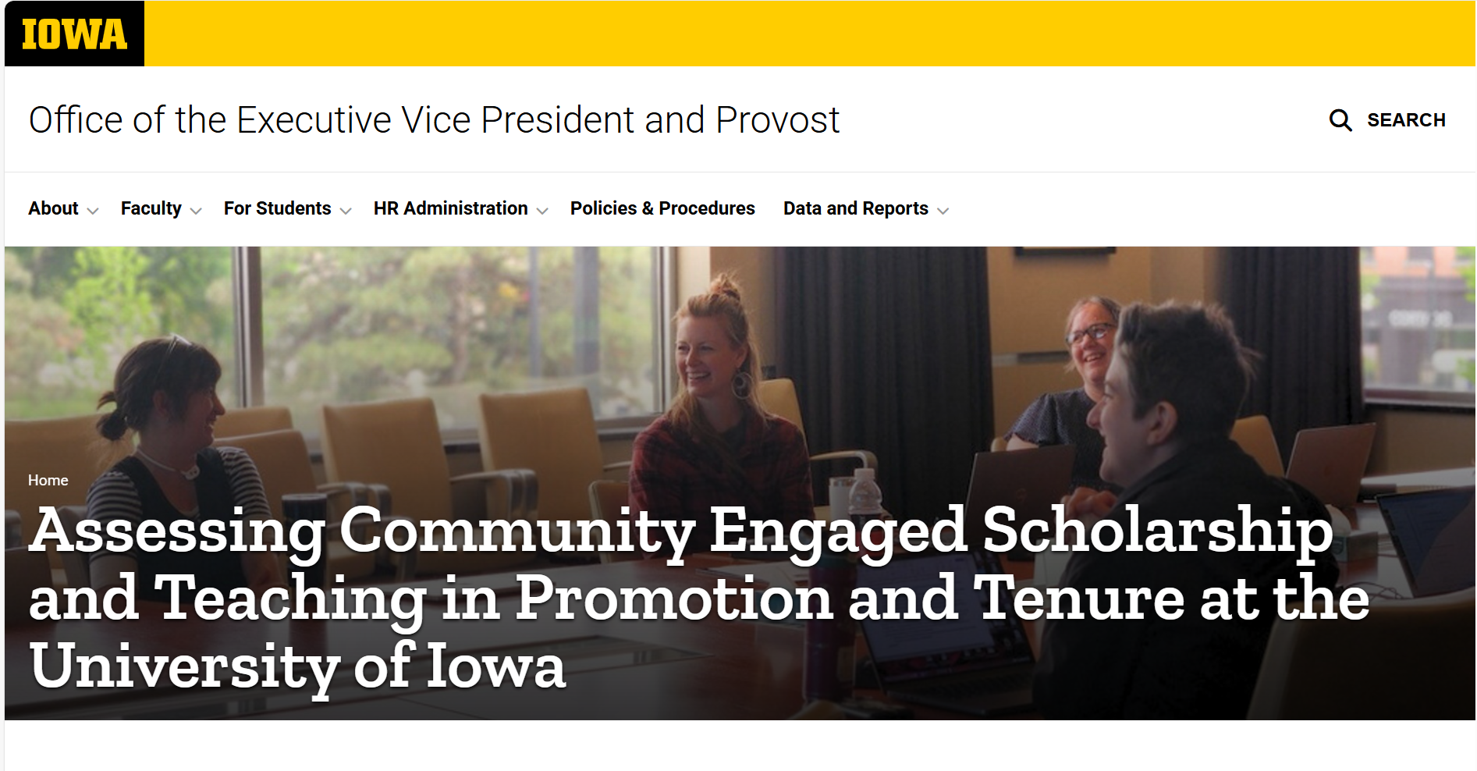
Provost Office guidelines

Slide 9
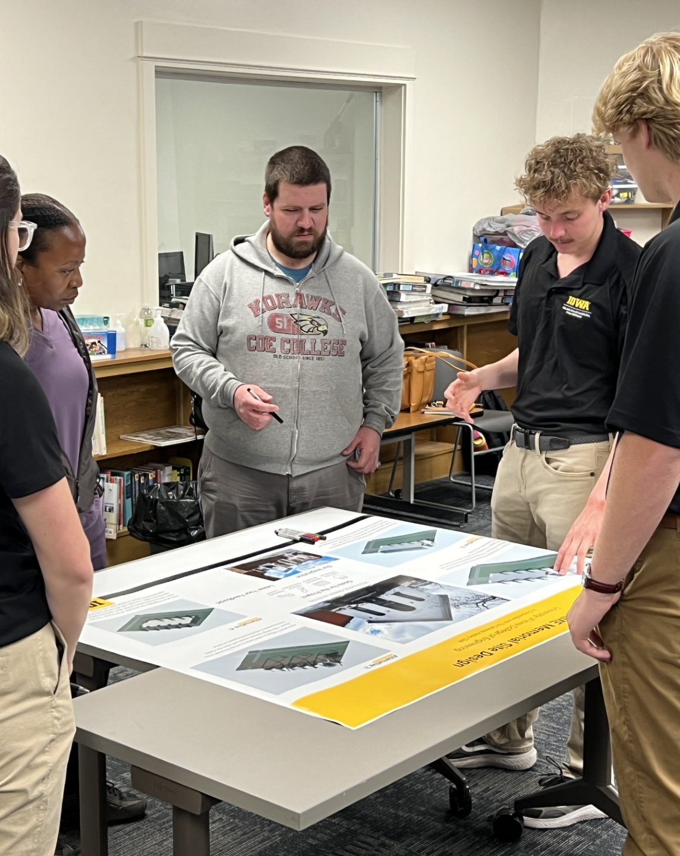
Lessons Learned (so far)
Collegiate leadership supportive of guidelines
  BUT…challenge comes with implementation
  “This isn’t an issue for our college”
Start with low-hanging fruit
  Early adopters: College of Public Health, College of Nursing
  No one wants to be first
Educational roadshow important – faculty and DEOs require handholding

Slide 10
FAQs from campus
Is this a mandate from the Provost? Is there flexibility with the guidelines?
How do I know as a faculty member if the guidelines are a good fit for me as I go up for promotion?
Will these guidelines serve as a crutch for faculty who would not otherwise be a strong candidate for promotion?
Do we really need to do this if faculty in our college/department don’t do community-engaged work?

Slide 11
Discussion
engagement.uiowa.edu

Slide 12

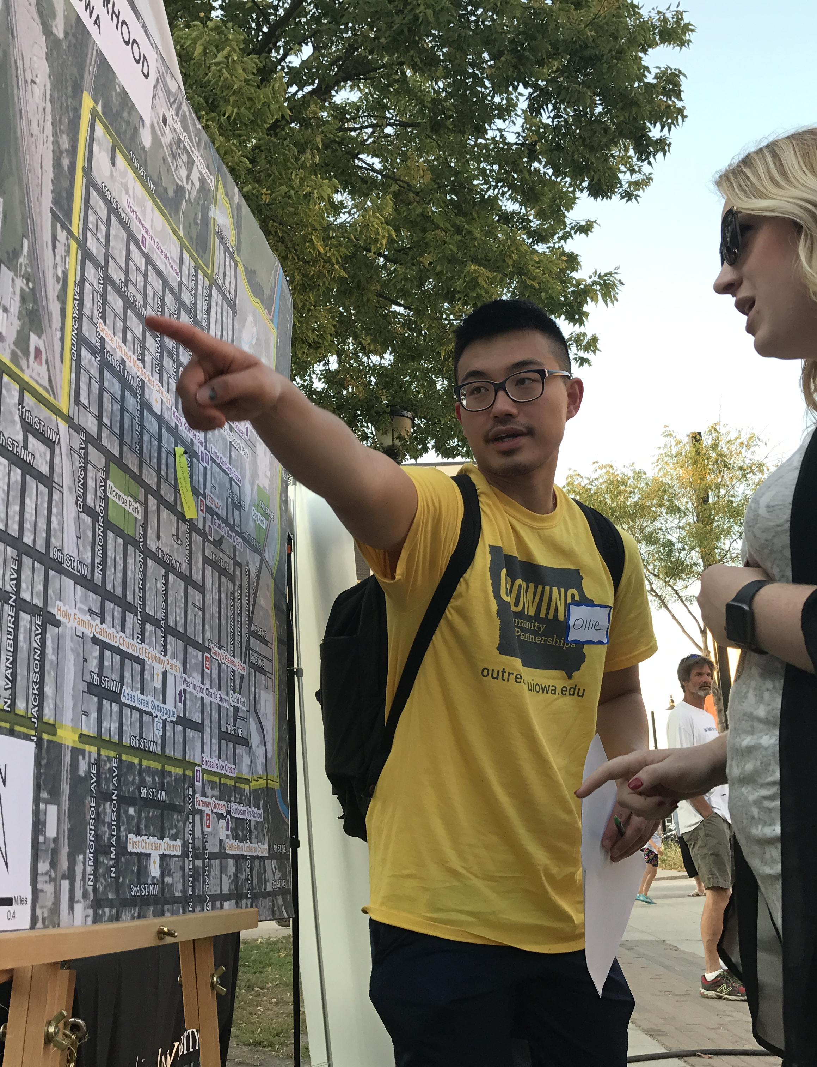
Community Engagement Network (CEN)
For Scholars and Practitioners
November 8th, 2023

