Slide 1

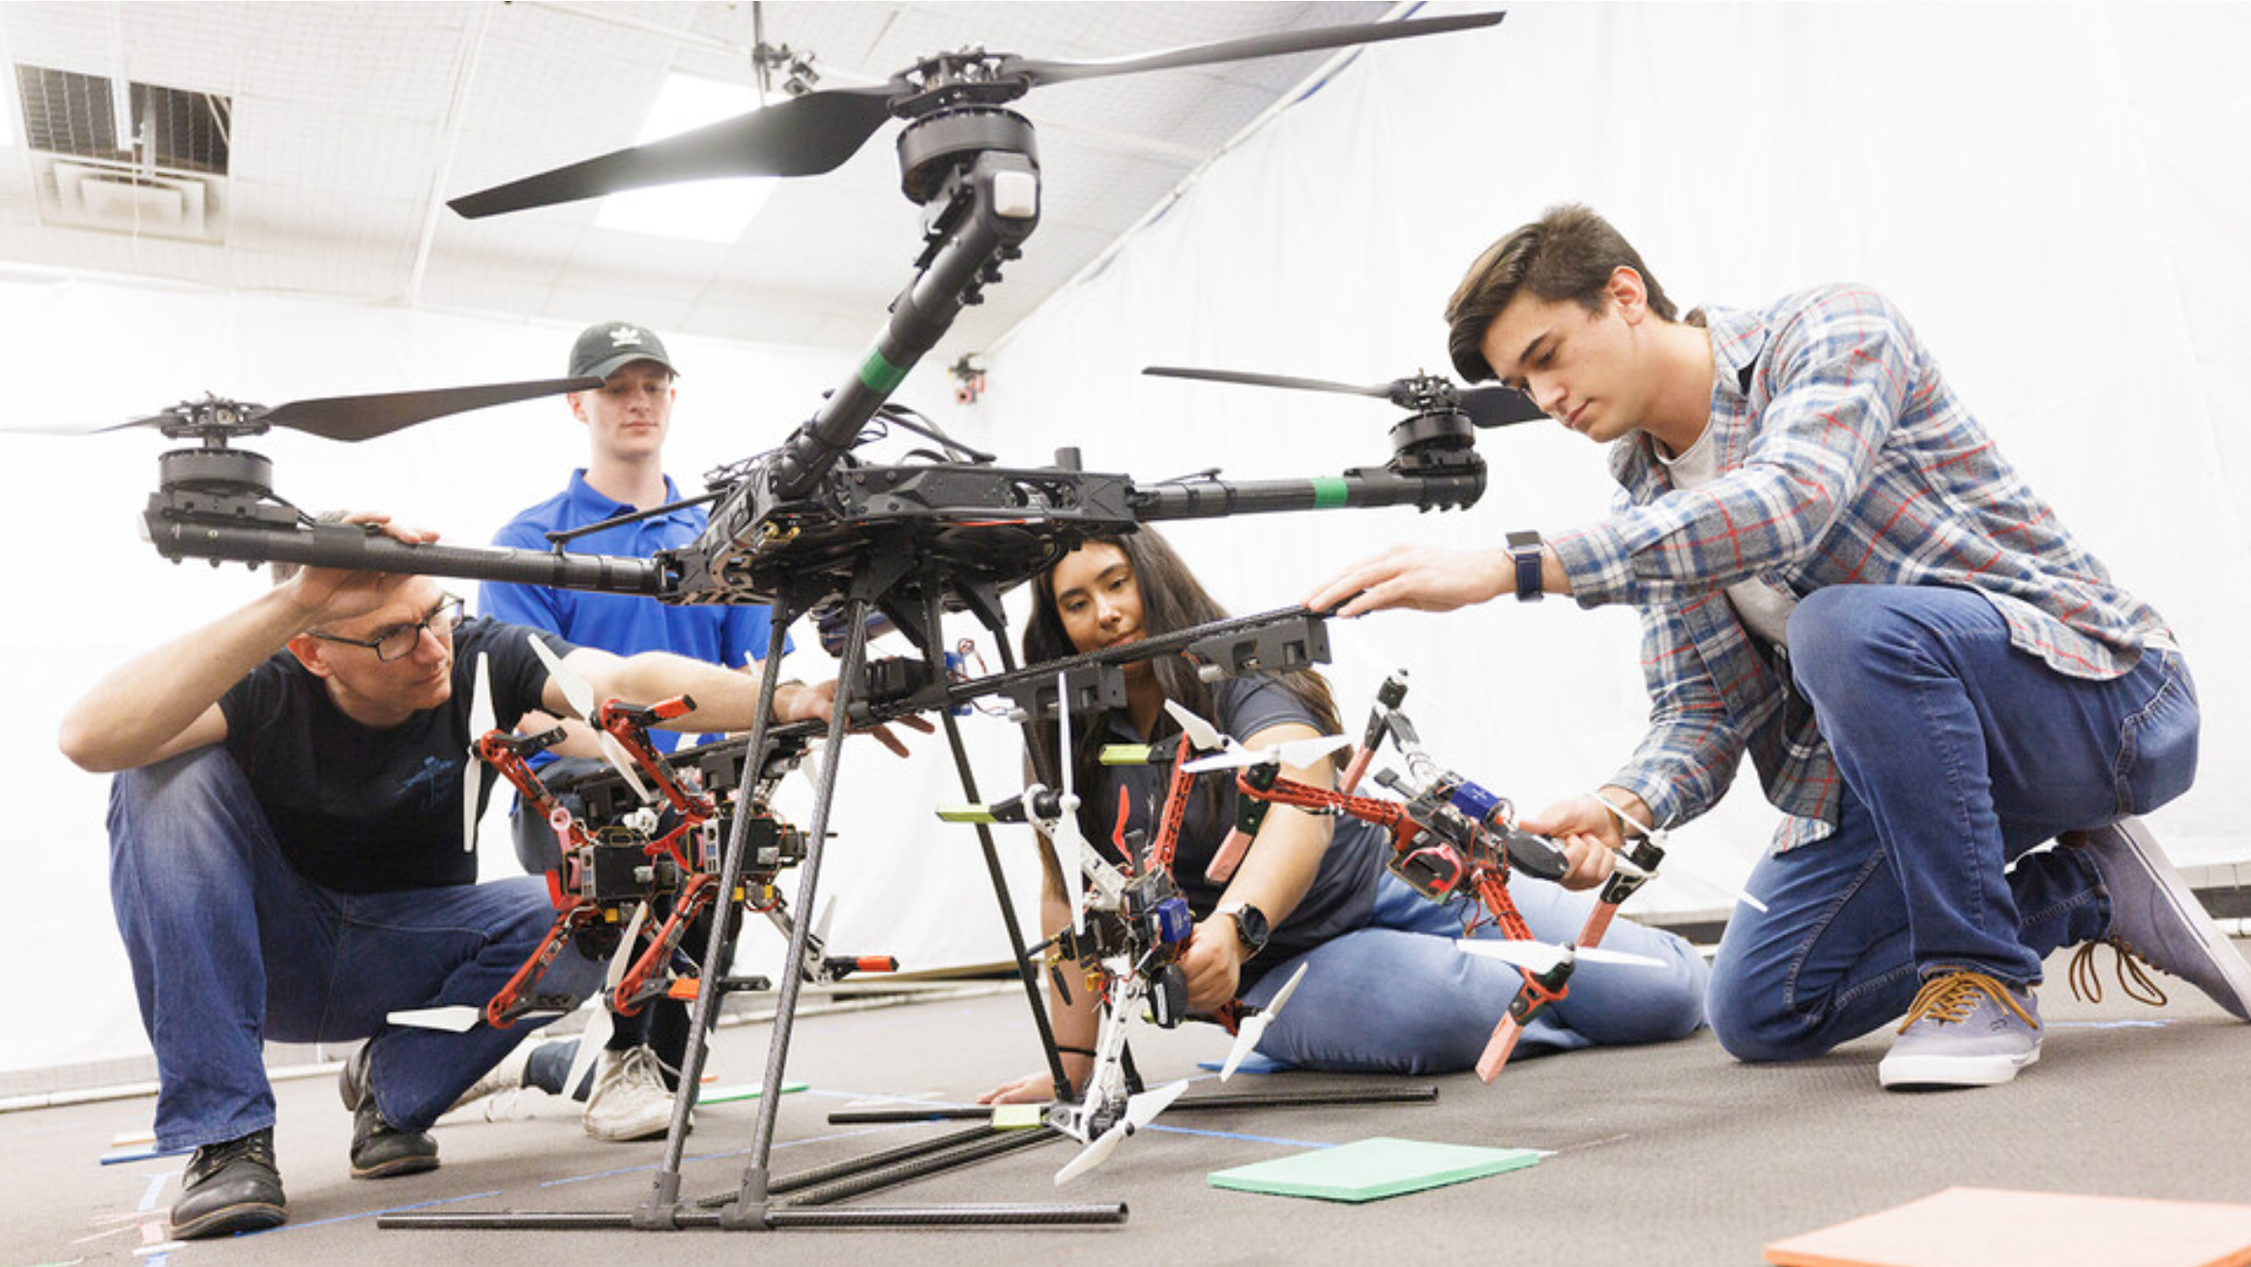
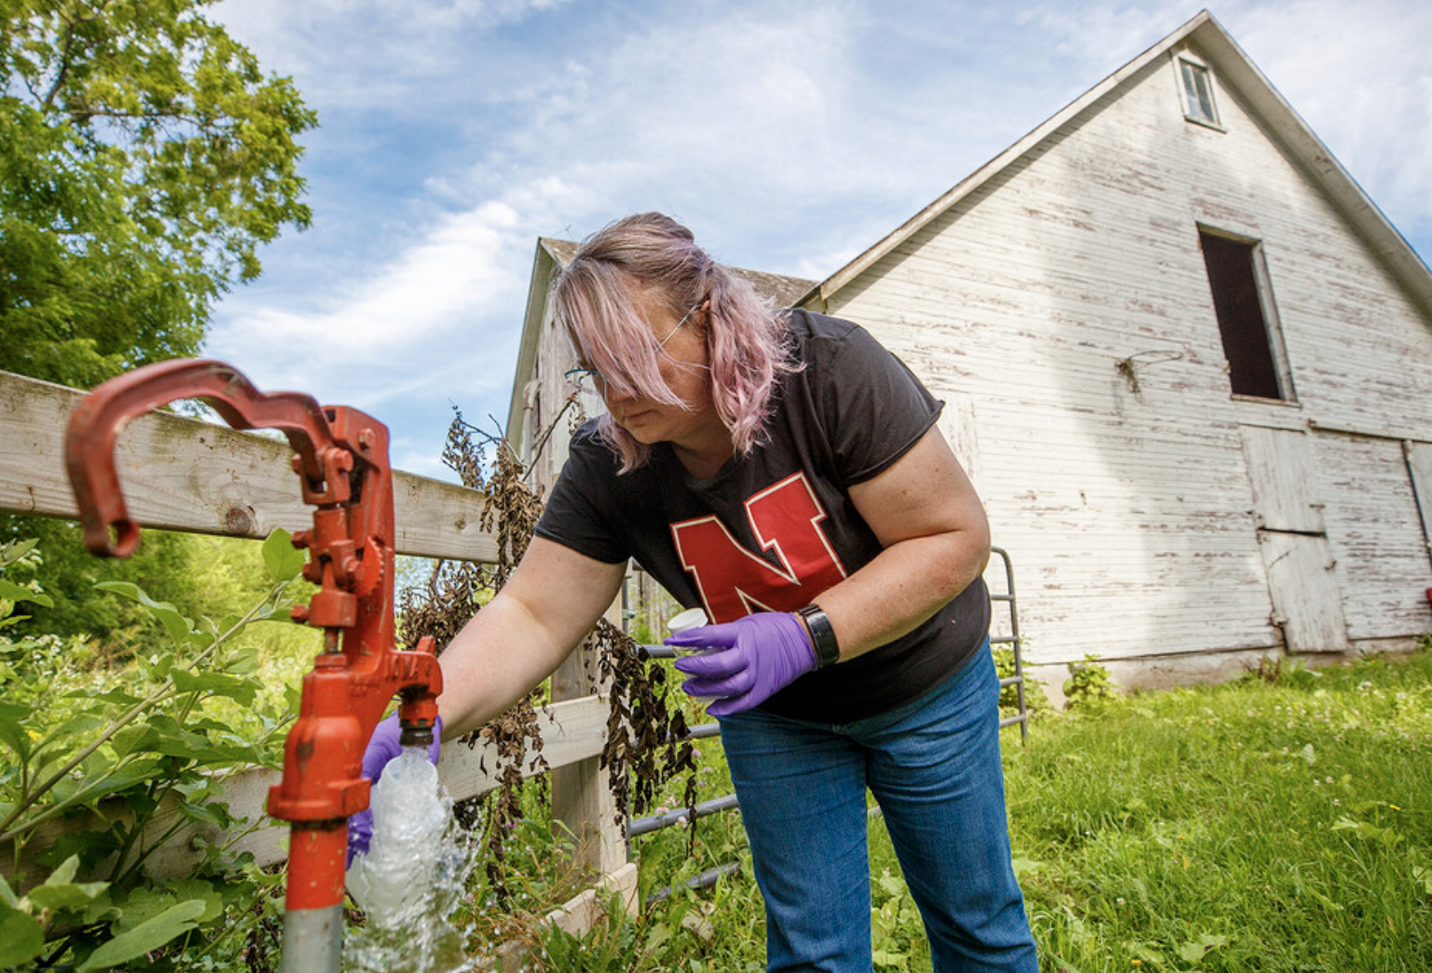
Kim Wilson, Special Assistant to the Dean, Chair of COE Engagement Committee
Yusong Li, Associate Dean for Faculty and Inclusion
COLLEGE OF ENGINEERING
Systematic Approach to Institutionalizing Engagement

Slide 2

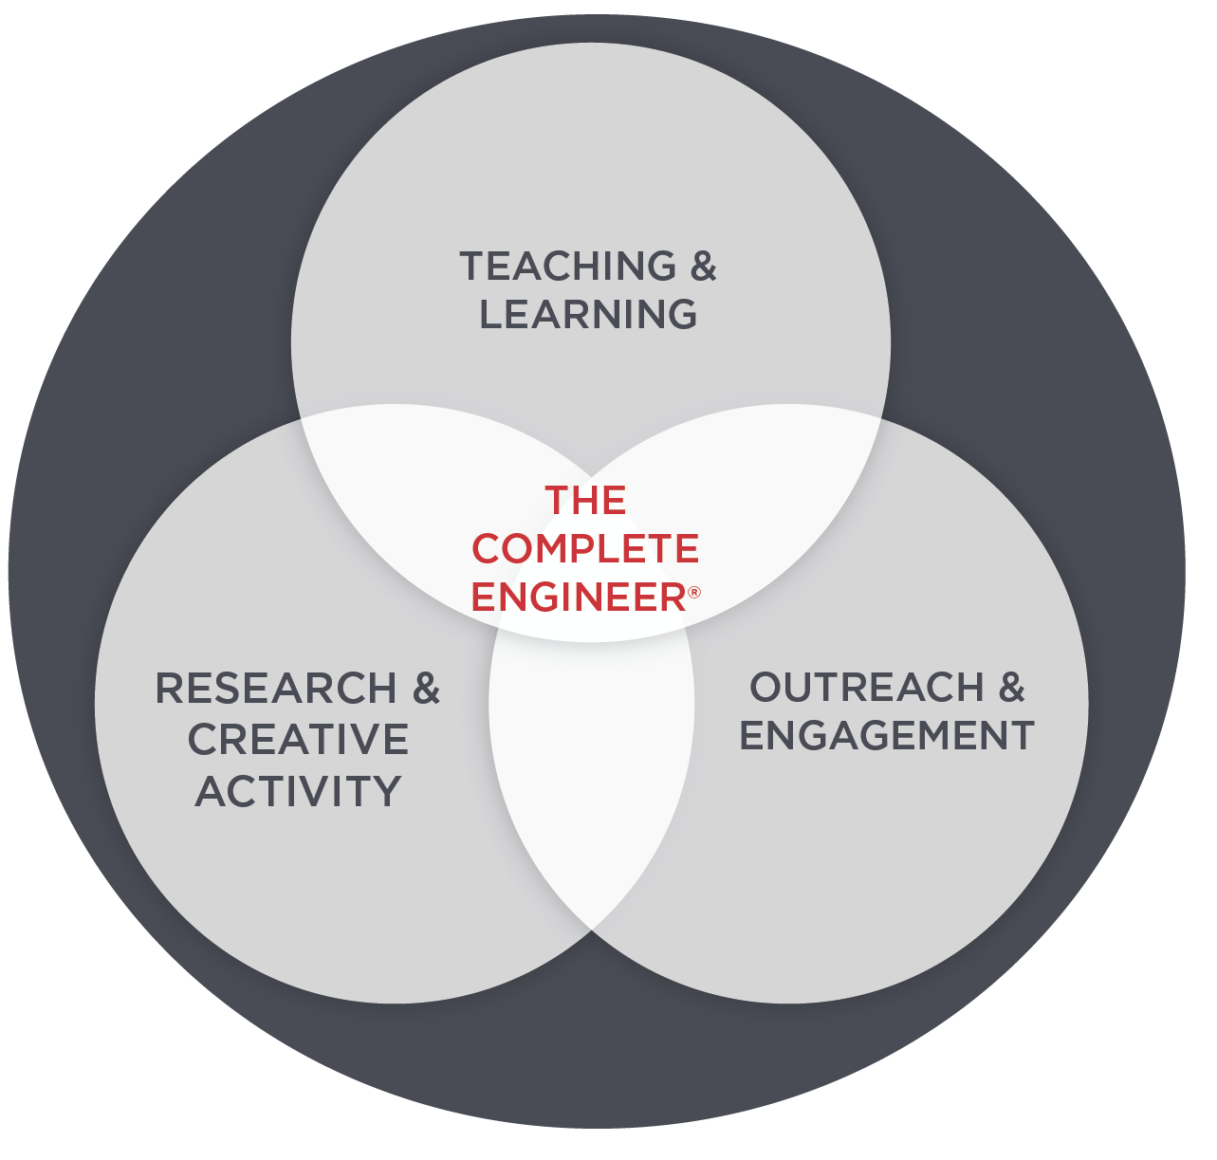

COE Strategic Plan
1
55
(OUT OF 205)
U.S. NEWS & WORLD REPORT
GRADUATE RANKING
2
3
We teach. We do research. We serve the public.

Slide 3
COE Strategic Goal 3: Outreach and Engagement Strategies & Tactics
3
Advance college-wide engagement activities to build capacity and transform Nebraskans’ lives.
Collaborate with industry, communities and regions to leverage talent, innovation and resources.
1. Build engagement infrastructure and culture.
Hire/reapportion faculty and staff focused on engagement
Create first-class facilities for community and industry engagement
Establish a state-wide engagement advisory board
Recognize student and club engagement projects and impact
2. Increase college engagement activities.
Expand COE partnerships with NU Extension
Engagement alumni, industry and communities to develop statewide engagement program
Develop a logic model that assists faculty in identifying and implementing engagement activities.
Seek external funding.
3. Expand statewide K-12 outreach and engagement activities.
Partner with high school teachers.
Partner with Nebraska Extension to Develop statewide K-12 engineering outreach programs
4. Do impactful engagement projects.
Support faculty/staff/student nominations for regional and national engagement awards and attainment of leadership and Fellow roles in professional societies.
Recognize and celebrate engagement through yearly review process and college-wide awards and events/ ceremonies
Communicate stories and impact with the public/targeted audiences.
55
(OUT OF 205)
U.S. NEWS & WORLD REPORT
GRADUATE RANKING
COLLEGE OF ENGINEERING

Slide 4
Institutionalizing Engagement – Systematic Approach
Established a college-wide Outreach and Engagement Committee (COEC)
  Completed - Foundational work – literature review, vocabulary, definitions, and resources
  Completed - Unit head workshop – buy-in and priorities
  Completed - Departmental presentations and surveyed faculty about current outreach and engagement activities
  Completed - College-wide Awards Program
  Ongoing - Tiered approach to faculty development
  Ongoing - Integrating Scholarship of Engagement into annual evaluation and P&T criteria
  Ongoing - Outreach and Engagement Website – recognition, resources, and partnerships
55
(OUT OF 205)
U.S. NEWS & WORLD REPORT
GRADUATE RANKING
COLLEGE OF ENGINEERING

Slide 5
Unit Head Workshop > Buy-in
1. How can we leverage engagement to recruit new faculty?
clear ways to define, quantify, and reward engagement; built-in partnerships; summer workshops; demonstrate value towards P&T; start-up funding; highlight in new faculty positions
2. How do we show that we value engagement? What can we implement to show we value engagement?
reward faculty; celebrate engagement; part of annual reviews; part of P&T; designated apportionment; staff support; regular communication from leadership; highlight stories; award and recognition
3. What would you include in a workshop series?
gamification; external and potential partners; good food; nationally recognized experts; pitch competitions; resources; graduate students involved
4. Who do you know that is currently doing scholarship of engagement work?
identified 42 COE faculty
COLLEGE OF ENGINEERING

Slide 6
Survey Results
Fall 2021 Survey > 52 Faculty engaged with move than 150 Partners
16+ Municipalities
28+ State/Fed. Agencies
31+ Non-Profits
44+ Companies/Industry
12 Public Schools
5 Hospitals
3 Universities
City of Toronto, City of Lincoln, City of Columbus, Kianjavato (Madigascoar), Sidowe (Zambia), Lancaster County, City of Valentine, City of Fremont, City of Yutan…….
Nebraska DOT, Nebraska Game and Parks, National Park Service, US Corp of Engineers, Lower Platte South NRD, Nebraska Department of Education, NPPD….
City Sprouts, People City Mission, Lincoln Children’s Museum, Young Life, F Street Community Center, Lincoln Bike Kitchen, Good Neighbor Center, Meyhew Cabin…..
Olsson Engineering, Chief Buildings, Hawkins Construction Company, manufacturing, SOFWERX, Nokia, NCEA, DLR, local construction companies...
Lincoln Public Schools, State School District, local schools, middle schools, Cambodia School for Girls…….
Madonna Rehabilitation Hospital, Methodist Hospital, UNMC
UNMC, UNL Athletics, UNL Facilities and Planning
COLLEGE OF ENGINEERING

Slide 7
College-wide Engagement Awards Program
Established in 2023
Presented annually to up to two awards in the College of Engineering for outstanding accomplishments in "engagement in research, teaching and/or service” related to work with an external partner.
Open to all faculty ranks
Each recipient of this award receives $2500.
Evaluation criteria:
Scholarship: Is there strong evidence that the work has been received and recognized by the community of scholars most appropriate to the field of endeavor?
Community Partnership: Does the work involve reciprocal, collaborative, and mutually beneficial working relationships with community stakeholders?
Documented Impact: Has the impact of the work on community stakeholders been studied, understood, and reported? Is the impact sustainable?
COLLEGE OF ENGINEERING

Slide 8



Tiered Approach to Faculty Development
Tier One:
Theme: Murder Mystery
.
Four Workshops:
What is Engagement?
‘Program’ Integration
Communication & Evaluation
Impact & Pitch
Offered:
Fall through Spring Sem.
each academic yr.
Recognition:
$ 5,000 – 1st pitch winner
$ 2,000 – 2nd
Gift certificate – Solving Murder Mystery
Tier Two:
Theme: Bake Off &
Pitch Off
.
Three Workshops:
Team Building & Impactful Collaboration
Establishing Partnerships
Pitch with Partner
Offered:
Fall Semester
each academic yr.
Recognition:
$ 2,000 – 1st pitch winner
$ 1,000 – 2nd
COLLEGE OF ENGINEERING

Slide 9
Tiered Approach to Faculty Development
Tier Three:
Scholarship of Engagement Fellows Program 2025-27
Purpose: to foster the development of the scholarship of engagement in support of the promotion and/or tenure process.
Develop with a partner a project with societal benefit and scholarly output and impact.
Attend four 2-hour workshops & participate in a COE Rural Nebraska Tour (May 2025).
Demonstrate understanding of the scholarship of engagement through completion of a scholarly work(s).
Award of a $2,000 stipend matched by the Unit (total $4,000) to spend towards supporting the engagement partnership and project.
Participate in Fall 2025 COE Engagement Forum.
Assist in mentoring future faculty fellow cohorts.
COLLEGE OF ENGINEERING

Slide 10
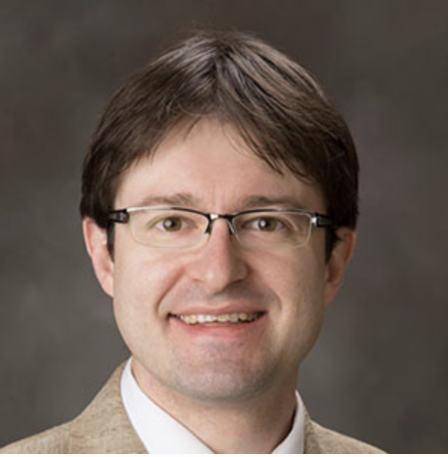
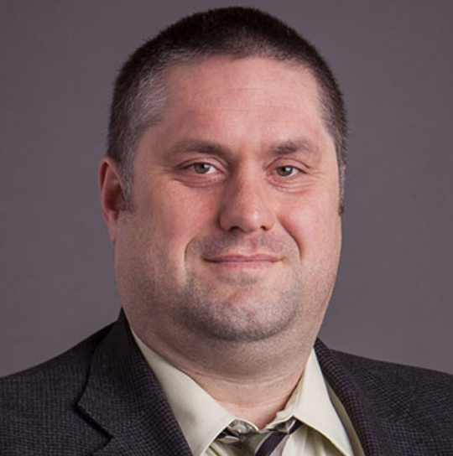
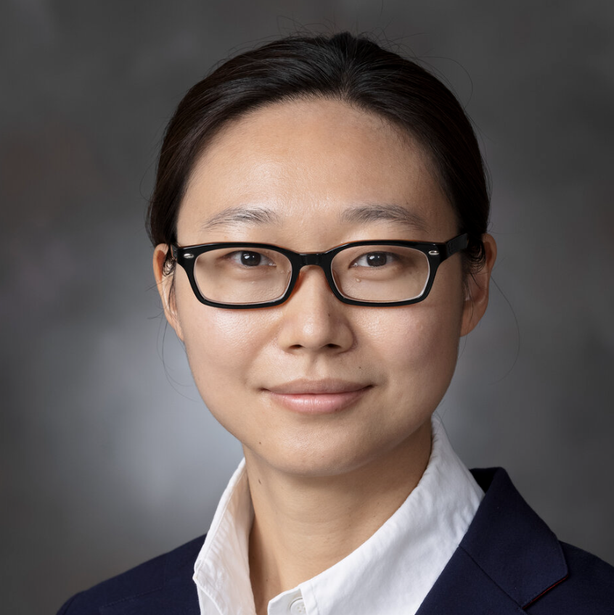
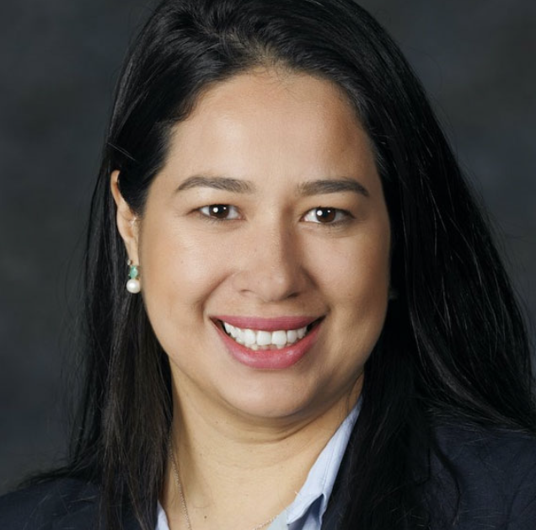
COE Scholarship of Engagement Fellows 2025-27
Dr. Max Pierobon
Associate Professor, SoC
Engaged Research
“Apply research in bio-inspired information systems and human-technology frameworks to address Nebraska challenges.”
.
Dr. George Hunt
Associate Professor of Practice, CEE
Engaged Teaching and Learning
“Capstone class will partner with the Village of Niobrara to address environmental engineering issues.”
Dr. Shuai Nie
Assistant Professor, SoC
Engaged Teaching and Learning
“Co-design ‘K-to-college’ pathway to achieve responsible innovation and nurture the next-generation entrepreneurs through technology transfer.”
Dr. Jamilla Teixeira
Assistant Professor, CEE
Engaged Research
“Partnering with industry, DOT, and town administrators to co-create innovative applications for waste materials in construction.”
COLLEGE OF ENGINEERING

Slide 11
Integrate Engagement into Annual Evaluations
COEC worked through the Associate Dean for Faculty and Inclusion​
Associate Dean for Faculty and Inclusion worked with the Unit Heads
No engagement apportionment
Integrated into the Service category and called:
  C. Service and Engagement Accomplishments
  Can be integrated into teaching and research activities
  Working with faculty to successfully communicate these activities to their peers
SUMMARY OF ENGAGEMENT ACTIVITIES
Year | Engagement Category (teaching/learning, research, service) | Course/ Project Name | Partner(s) | Activities/Output (e.g. methods/tools developed, prof. development, presentations, publications, products/deliverable) | Validation/Impact (e.g. citations, awards, extension of funding, adoption of methods, benefit to partner)
Click or tap here to enter text. | Click or tap here to enter text. | Click or tap here to enter text. | Click or tap here to enter text. | Click or tap here to enter text. | Click or tap here to enter text.
Click or tap here to enter text. | Click or tap here to enter text. | Click or tap here to enter text. | Click or tap here to enter text. | Click or tap here to enter text. | Click or tap here to enter text.
COLLEGE OF ENGINEERING

Slide 12
Integrate Engagement into P&T Criteria January 2025
College Outreach and Engagement Committee (COEC) worked directly with the COE P&T Committee
Engagement Criteria included:
A Stated value: Engaging with people in the community in furthering the mission and vision of COE
Promotion from Assistant Professor to Associate Professor -
  Teaching criteria: Documented and demonstrated quality and impact of teaching may include community-engaged teaching that connects students and faculty members with activities that address community-identified needs through mutually beneficial partnerships that broaden or deepen students’ academic learning and civic engagement.
  Research criteria: Demonstrated quality and impact of research may include community-engaged research that connects students and faculty members with activities that address community-identified needs through mutually beneficial partnerships that broaden or deepen scientific inquiries, practical applications, policy making, and other societal impacts such as establishing or enriching non-profit organizations.
COLLEGE OF ENGINEERING

Slide 13

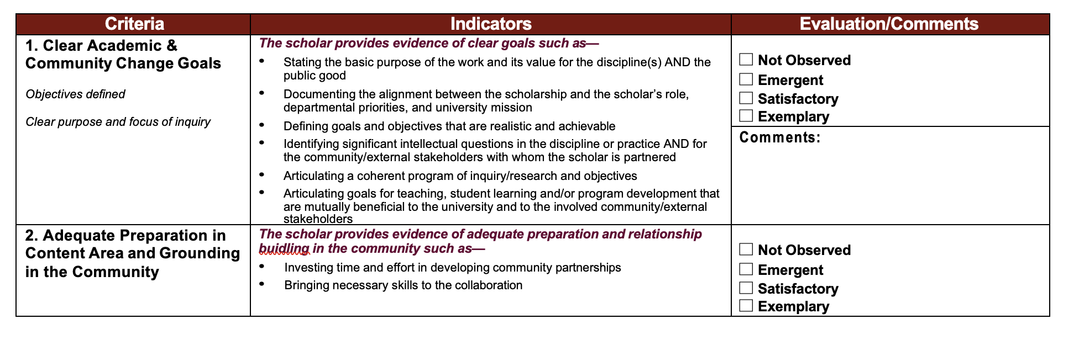
Ongoing Work with P&T Committee, Unit Heads and Faculty
COEC facilitating the P&T Committee to develop and adopt a College-wide Scholarship of Engagement Rubric – with criteria and well-defined indicators
  To assist faculty in conducting and communicating engagement in annual reviews and P&T documents
  To assist Unit Heads and P&T committee in the evaluation of engagement
COLLEGE OF ENGINEERING

